Slide 1
FHA Multifamily Production
Fiscal Year 2025 Summary
Source: PLUS
Date of data run: 11/20/2025

Slide 2
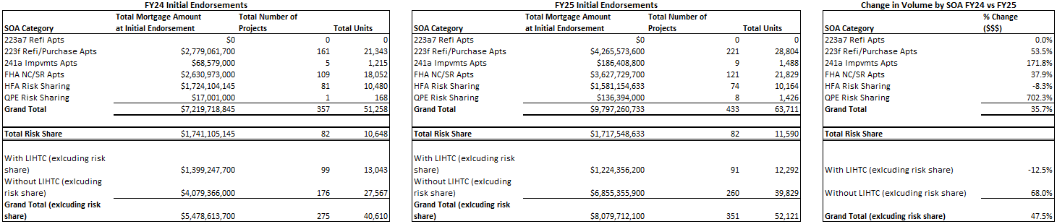
FHA Multifamily Production
Fiscal Year 2024 vs Fiscal Year 2025

Slide 3
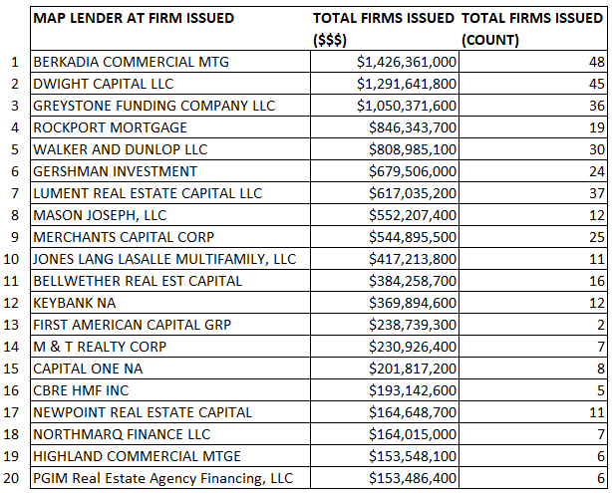
FY25 Firm Commitments by Lender (MAP Applications)

Slide 4
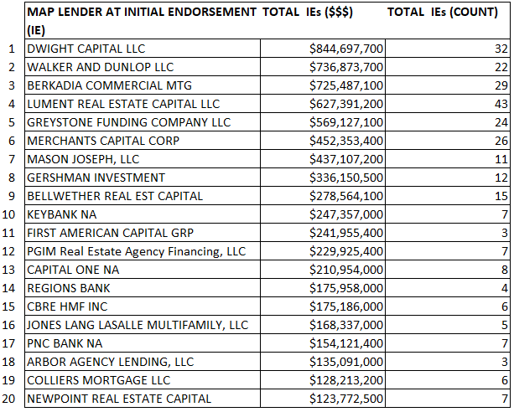
FY25 Initial Endorsements by Lender (MAP Applications)

Slide 5
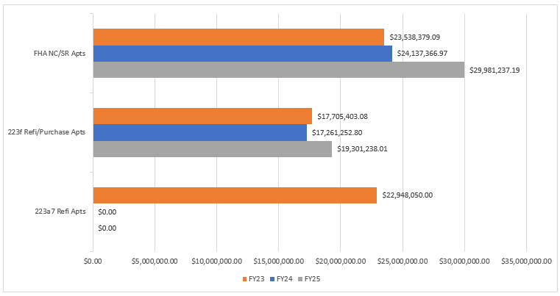
Average Loan Size at Initial Endorsement
FY23 – FY25

Slide 6
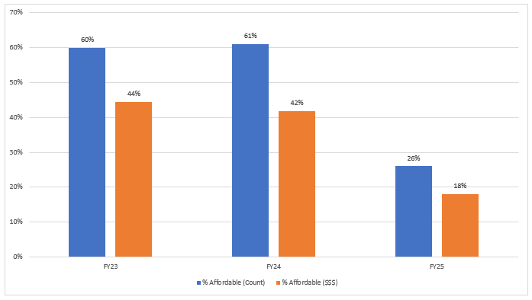
Percentage Affordable Firms Issued by Count and Volume FY23-FY25
(all MF Production SOAs including Risk Share)
*All projects that qualify for an Affordable or Broadly Affordable MIP rate based on the March 2016 Federal Register notice announcing changes to MIP rates are considered affordable for the purpose of this analysis.

