Slide 1

U.S. Department of Housing and Urban Development
FFATA Subaward Reporting System (FSRS)
Reporting at HUD
November 12, 2020

Slide 2
Session Agenda
Topics
Session Objectives, Overview, and Background
FSRS Roles and Responsibilities
Determining Requirements for FSRS Reporting
FSRS Portal Navigation
Reporting Frequency
Questions, Survey, and Closing

Slide 3
Session Objectives and Overview
OCFO is dedicated to confirming that reporting and compliance requirements for the CARES Act are accompanied by resources to support HUD stakeholders. The objectives for today’s session are to:
Provide an overview and background information on FFATA reporting and the FSRS system
Describe FSRS reporting roles and responsibilities for the HUD agency and contractors
Identify FSRS reporting requirements for prime recipients and sub-recipients/contractors
Describe FSRS reporting requirements for executive compensation
Demonstrate navigation and reporting options in FSRS
Share reporting frequency in FSRS
After the session, prime award sub-recipients/contractors are encouraged to complete FSRS reporting by January 10th, 2021 in alignment with the Pandemic Response Accountability Committee (PRAC) quarterly package for CARES Reporting.

Slide 4



Background: FFATA Requirements
Background
What is the Federal Funding Accountability Transparency Act (FFATA)?
The FFATA requires information about Federal awards to be maintained in a single, searchable website available to the public.
The FFATA was enacted in 2006 to collect information from prime recipient about executive compensation and sub-recipient/contractors.
Requires prime recipients to electronically report their sub-recipient/contractors activity for compliance.
Impacts of FFATA Reporting
nc
Increased transparency of government spending
Required by legislation, information on federal awards are made available to the public
Confirms grant recipients know and share requirements for reporting on sub-recipients with an emphasis on accuracy, timeliness, and efficiency

Slide 5
What is FSRS?
The FFATA Sub-award Reporting System (FSRS) is a reporting tool that Federal prime awardees (i.e., prime recipients and prime sub-recipients/contractors) use to capture and report sub-recipient/contractor awards and executive compensation data. For FSRS reporting at HUD, prime recipient awardees will report against sub-recipient/contractor awarded.
Below is an outline of the legislation requiring FFATA sub-recipient award reports for sub-recipients/contractors:
Grants
  In accordance with 2 CFR Chapter 1, Part 170, prime awardees awarded a federal grant are required to file a FFATA sub-award report by the end of the month following the month in which the prime awardee awards any sub-award equal to or greater than $30,000 in Federal funds that does not include recovery funds.
Additional information can be found on the FSRS website, at www.fsrs.gov.

Slide 6

FSRS Reporting Frequency
Frequency
Reporting in FSRS is expected to be submitted one month after the sub-recipient/contractor funds have been awarded. Once the prime recipient has submitted the sub-recipient/contractor data, there will be no further reporting deadlines for FSRS.
How FSRS Will Help With CARES Act Quarterly Reporting Dates
The CARES Act is at the forefront of HUD’s compliance focus. HUD strives to gather accurate data and meet requirements in a timely manner. All sub-recipient/contractor awards made within the following dates will be included in the CARES Act quarterly report submitted to the PRAC.
CARES Act PRAC Quarterly Reporting Deadline | Sub-recipient/Contractor Award Information To Be Gathered for PRAC Quarterly Submission:
7/10 | All sub-recipient/contractor awards through 5/31
10/10 | All sub-recipient/contractor awards through 8/31
1/10 | All sub-recipient/contractor awards through 11/30
4/10 | All sub-recipient/contractor awards through 2/28

Slide 7




FSRS: Roles and Responsibilities
The boxes below outline the roles and responsibilities of key stakeholders that support FSRS reporting and compliance.
HUD HQ: Office of the Chief Financial Officer (OCFO)
The Office of the Chief Financial Officer or OCFO provides Program Offices with timelines and compliance requirements for FSRS reporting.
HUD HQ: Program Office
Jim is responsible for managing overall program compliance. He also reviews FFATA reporting to measure program compliance. Jim is expected to communicate FSRS reporting timelines (shared by OCFO) and to coordinate with Office of Field Management to send deadline reminders to the Field Offices for dissemination to grant recipients.
Prime Recipient
Dwight’s organization is a prime recipient of a HUD grant. Dwight is responsible for reporting sub-recipient/contractor data in FSRS in accordance with the reporting deadlines communicated from the HUD program office. Dwight is expected to ask questions to clarify his understanding of FSRS requirements.
Jim Halpert
Dwight
Schrute
HUD Field Office
Michael (Field Office staff) receives program guidance and instruction from HQ Program staff and coordinates with HQ Program Offices and HQ Office of Field Management on the dissemination of FSRS deadline reporting reminders to grant recipients.
Sub-recipient/Contractor
Pam’s organization is a sub-recipient/contractor to the grant Dwight’s organization received from a HUD Program Office. Pam is expected to provide all reporting information the prime recipient (Dwight) needs to complete FSRS submissions.
Michael Scott
Pam Beesly

Slide 8
When do prime recipients report subawards in FSRS?
This decision tree below outlines the process of determining whether the prime recipient is required to complete FSRS reporting.
Grants
Did the prime recipients receive a grant greater than or equal to $30,000 in Federal funds?
Yes
No
Did the prime recipients award the money to another party greater than or equal to $30,000 in Federal funds?
Do not have to complete FSRS entry
Yes
No
Report the sub-recipient/contractor activities in FSRS
Do not have to complete FSRS entry
For more information on exceptions related to FSRS reporting decision making, please follow this link: https://www.law.cornell.edu/cfr/text/2/170.110

Slide 9
FFATA Reporting Requirements for Sub-recipients
Scenario: Pam, a grant award sub-recipient/contractor, just had a conversation with Dwight, her company’s prime recipient awardee, on compliance reporting requirements. Dwight mentioned an upcoming FSRS quarterly reporting deadline for prime recipients to provide data on sub-recipients/contractors awards. The conversation made Pam think, “What information will we need to provide to Dwight to report our sub-recipient/contractor award in FSRS?”
Pam Beesly
FSRS reporting requires the following data elements for any grant award greater than $30K:
Name of entity receiving the sub-award
Amount of sub-award
Funding agency
CFDA program number for grants
Program source/Treasury Account Symbol (TAS): Account Code
Award title descriptive of the purpose of the funding action
Location of the sub-award entity (including congressional district)
Place of performance (including congressional district)
Unique identifier of the entity and its parent

Slide 10
FFATA Executive Compensation Requirements
In addition to the reporting requirements outlined for sub-recipient/contractor, FFATA also includes a requirement for both prime recipients and sub-recipient/contractor on reporting executive compensation.
The following criteria and items required for reporting are the same for both prime recipients and sub-recipients/contractors, with the only key difference being the system they are reported in:
Key criteria |  | Items to be reported*
80% or more of prior year annual gross revenues are from Federal awards; and $25 million or more in annual gross revenues are from Federal awards; and The public does not have access to compensation information filed under Securities and Exchange Commission (SEC) and IRS requirements |  | If key criteria one and two are met, the following items must be reported by the prime recipient Total Compensation, and Names of the top five executives
  *Please note that FFATA reporting requirements are not applicable to classified information or if the organization had gross income of under $300,000 from all sources
Executive Compensation Roles and Responsibilities:
Prime Recipient
Prime recipient report their executive compensation information in the System for Award Management (SAM)
Sub-recipient/Contractor
Sub-recipient/Contractors provide this information to the prime recipients, who then enter this information into FSRS
Dwight
Schrute
Pam Beesly
10

Slide 11
FSRS Training Video Links
Below are resources found in the training video on FSRS.gov:
Topic | Video Timing
Sections and fields found on the FSRS login screen | 3:48 – 6:54
FSRS login/registration process | 6:55 – 10:49
Navigation of the FSRS homepage | 10:50 – 10:57
Resources section webpage FSRS reporting guides Templates for batch upload of FSRS reporting data | 10:58 – 13:32
Profile section page Change information on recipient profile Change password | 13:40 – 14:19
Methods for submitting FSRS reporting data | 14:20 – 30:44
Link to FSRS.gov video training:
https://www.fsrs.gov/documents/FSRS_Awardee_User_Demonstration.mp4

Slide 12
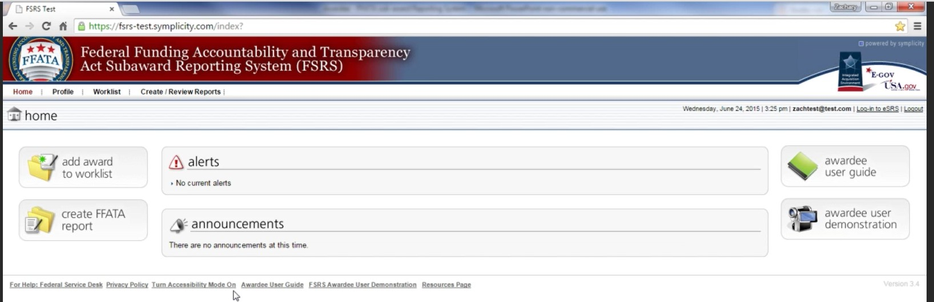
Entering Sub-recipient/Contractor Data into FSRS
Scenario: Dwight logs into the FSRS system to input sub-recipient/contractor award information. On the home page of the FSRS Reporting System, there appears to be multiple options for Dwight to input data. Dwight wonders, “What are the different submission methods listed on the homepage?”
Dwight Schrute
Let’s take a minute to review a quick navigation of the FSRS Home Screen
Link to FSRS Navigation Demonstration: https://www.fsrs.gov/documents/FSRS_Awardee_User_Demonstration.mp4

Slide 13
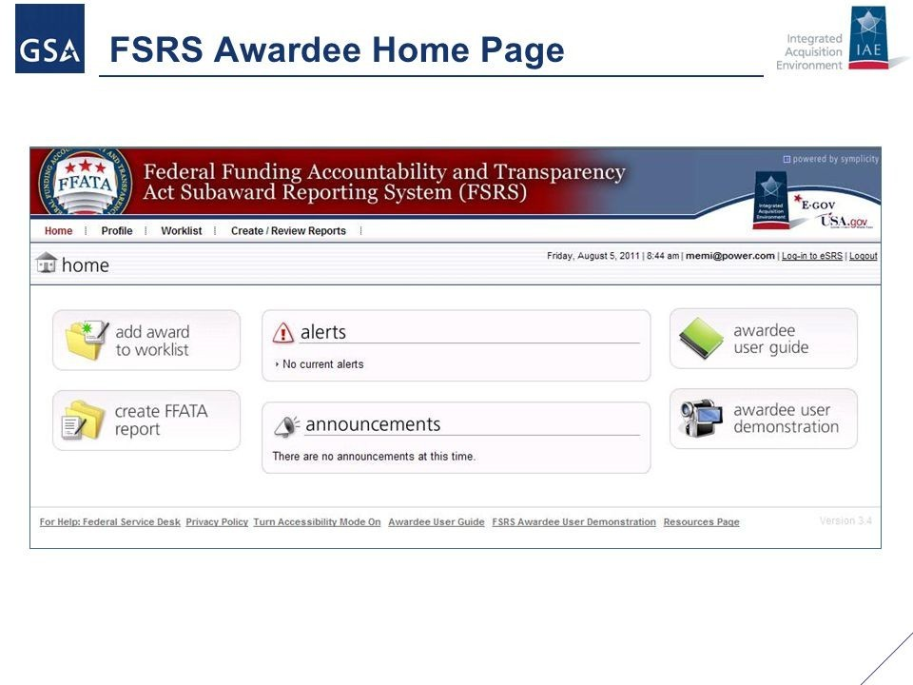
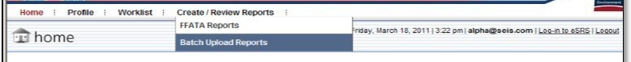
Methods to Submit Reports
Below are three different ways for the prime recipient to submit FSRS reports:
For more information, see FSRS Video:
Worklist Navigation | 14:20 – 15:49
Create FFATA Report Navigation | 15:50 – 28:31
Batch Upload Reports Navigation | 28:32 – 30:44
1
Worklist – allows the prime recipient to manage and review the awards for which they have a reporting responsibility. The user can search for and add awards to their worklist from grants reporting through the Agency’s Federal Assistance Award Data System (FAADS+) submissions to USAspending.gov
2
FFATA Reports – The FFATA Reports section allows a user to add a new FFATA Report and review existing FFATA Reports
3
Batch Upload Reports – The Batch Upload Reports section allows a user to file multiple FFATA Reports at once

Slide 14
FSRS Reporting Resources
Below are additional resources for information on FSRS reporting:
Topic | Website Link
FSRS General Information | https://www.fsrs.gov/index
FSRS Frequently Asked Questions | www.fsrs.gov/#a-faqs
FSRS Reporting for CDBG Recipients (2010) | https://files.hudexchange.info/resources/documents/ffata-subaward-reporting-system-webinar-slides.pdf
FSRS Reporting FAQs for Exec Compensation | https://files.hudexchange.info/resources/documents/transparency-act-executive-compensation-subaward-reporting-faqs.pdf
Dear Tribal Leaders CARES Reporting | https://www.hud.gov/sites/dfiles/Main/documents/Dear-Tribal-Leaders-CARES-reporting.pdf

Slide 15

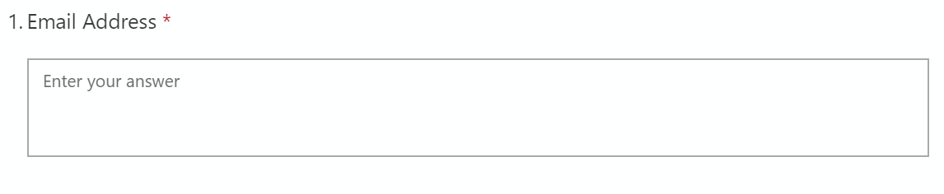
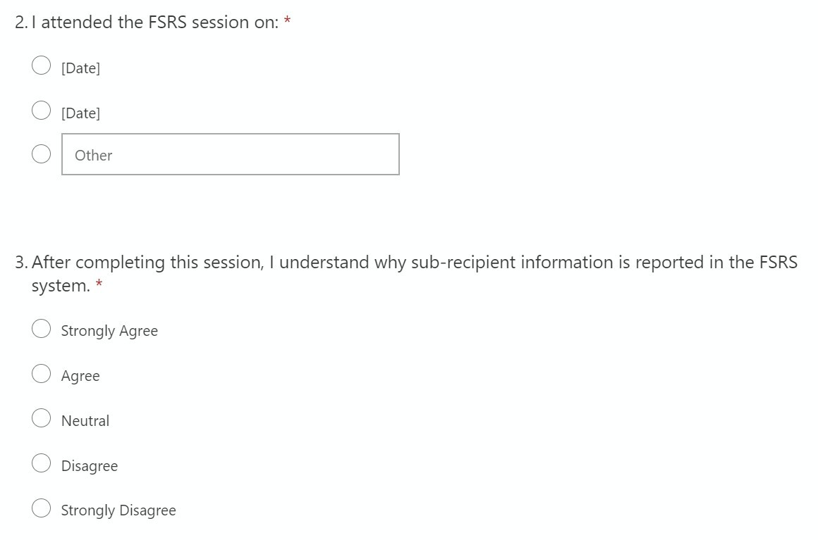
FSRS Session Survey
The HCCRT welcomes your feedback on our session today. Please follow the link below to share your feedback.
https://forms.office.com/Pages/ResponsePage.aspx?id=mT-XW99360uyfaoMcLhILKgbK61NuBJCvBl7EDf5MopUM00zTTE5VkNRVEU2N1I4VVVPWEQ3S0NFOS4u

