Slide 1

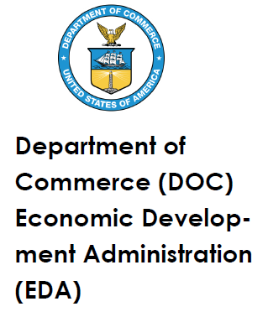
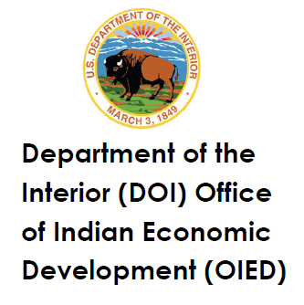

Federal Resources for Tribal Economic Development
FEDERAL RESOURCES FOR TRIBAL ECONOMIC DEVELOPMENT
JUNE 2, 2022
June 2, 2022

Slide 2
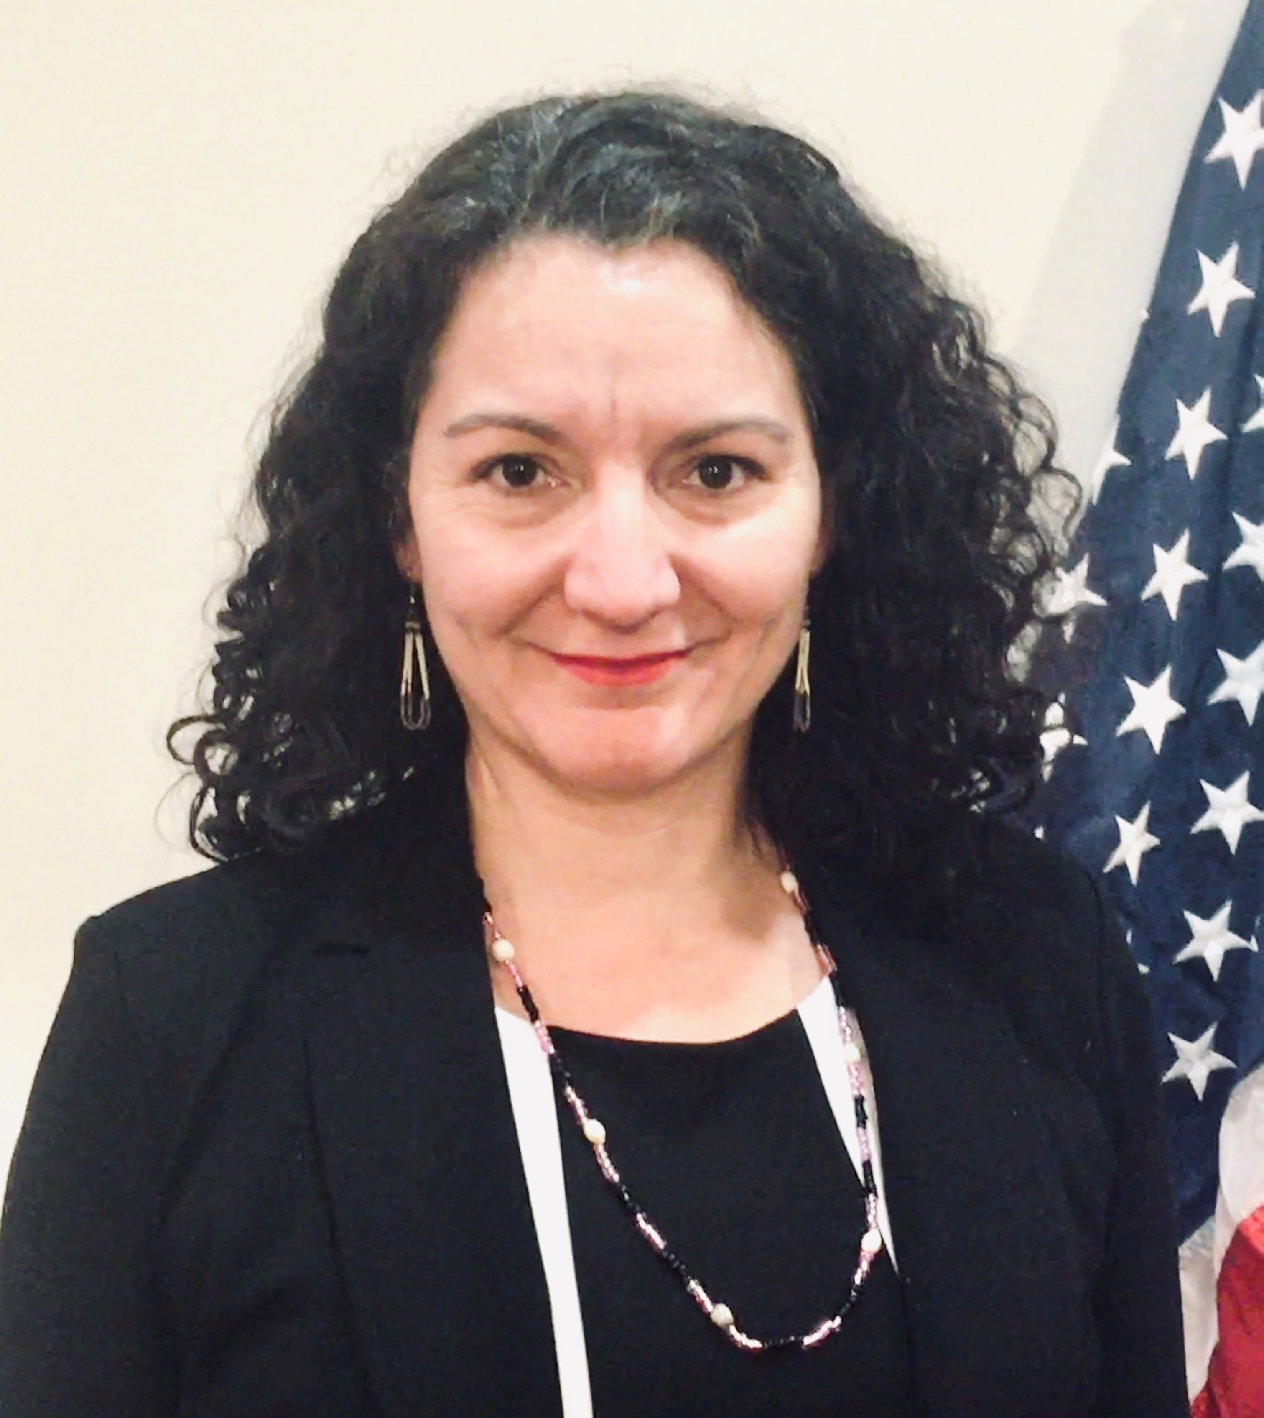
ADMINISTRATION FOR NATIVE AMERICANS (ANA)
Michelle Sauve (St. Regis Mohawk Tribe)
Executive Director, Secretary’s Intradepartmental Council on Native American Affairs
Administration for Native Americans
U.S. Department of Health and Human Services

Slide 3
AGENDA
Department of Commerce – Economic Development Administration
Carolee Wenderoth, Tribal Engagement Coordinator
DOI – Office of Indian Economic Development
Onna LeBeau, Director, Office of Economic Development
Denise Litz, Chief, Division of Economic Development
HHS – Administration for Native Americans
Michelle Sauve, Exec. Director, Secretary’s Intradepartmental Council on Native American Affairs
HUD – Office of Native American Programs
Jimese Price, Grants Management Specialist

