Slide 1

Indian Community Development Block Grant
American Rescue Plan (ARP) Tribal Consultation
March 31, 2021

Slide 2
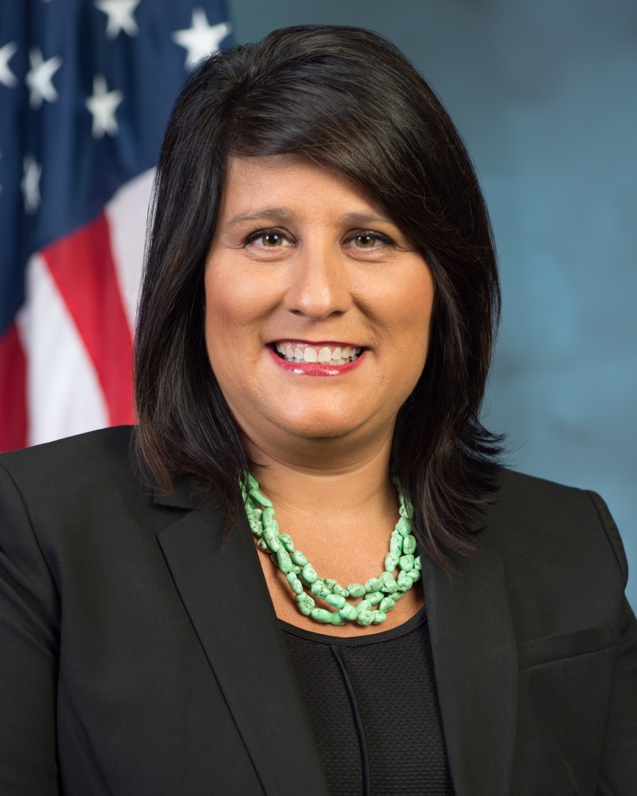
Office of Native American Programs (ONAP)
Heidi J. Frechette
Deputy Assistant Secretary
Office of Native American Programs
Department of Housing and Urban Development
Office of Native American Programs
Homepage: www.hud.gov/codetalk Mailbox: Codetalk@hud.gov

Slide 3
Purpose
On March 11, 2021, President Biden signed the American Rescue Plan Act of 2021 (ARP) (Public Law 117-2) into law.
ARP provides additional funding to prevent, prepare for, and respond to the COVID-19 pandemic, including $280 million for the Indian Community Development Block Grant (ICDBG) program.
This funding will be used to provide ICDBG Imminent Threat (ICDBG-ARP) grants to Indian tribes to eliminate or lessen problems that pose an imminent threat to public health or safety of Tribal residents.
HUD is conducting Tribal consultation to inform how the Department will administer the ICDBG-ARP program.

Slide 4
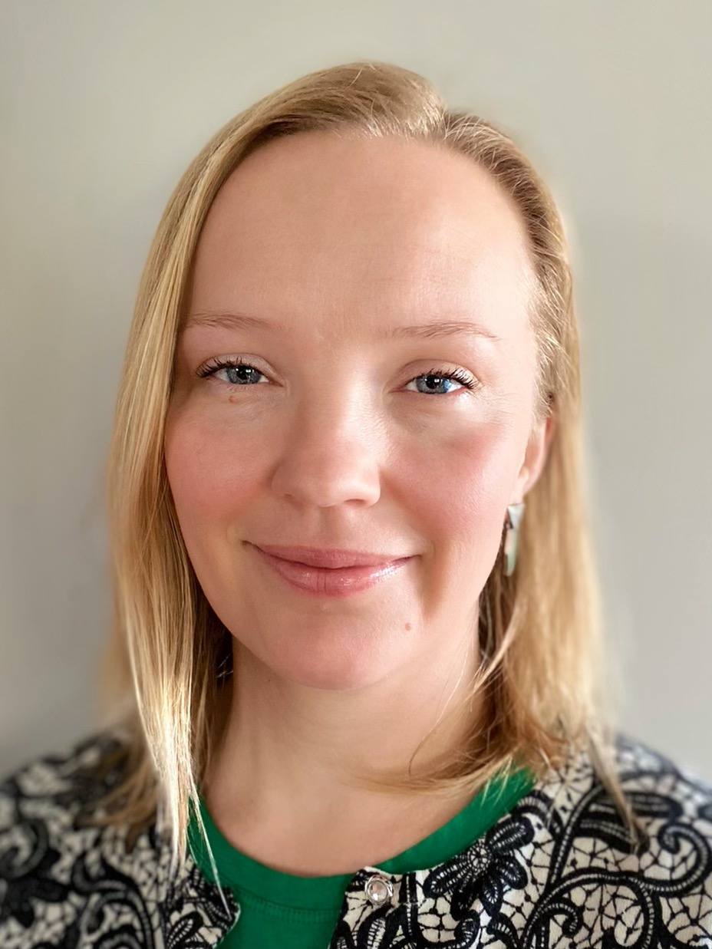
ONAP Grants Management
Hilary Atkin
Grants Management Director
Office of Native American Programs
Department of Housing and Urban Development
Office of Native American Programs
Homepage: www.hud.gov/codetalk Mailbox: Codetalk@hud.gov

Slide 5
ICDBG-ARP
On March 19th, HUD issued a Dear Tribal Leader letter to solicit feedback on the how the Department should administer ICDBG-ARP funds and provided the following proposed topics to respond to:
Maximum grant ceilings for the ICDBG-ARP.
Priority consideration for Indian tribes that submitted applications and were not awarded grant funds for ICDBG-CARES.
Eligibility for Indian tribes that were awarded an ICDBG-CARES grants
Other areas of consideration for the ICDBG-ARP Implementation Notice, program funding criteria, and other program requirements.

Slide 6
Provided Feedback
Since HUD issued the ICDBG-ARP DTL, ONAP has received feedback covering the following themes
Examples:
Give priority for eligible applicants that were not funded by ICDBG-CARES
Don’t exclude Tribes that were previously awarded ICDBG-CARES funds
Grant ceilings “are fine”
We are looking forward to more today.

Slide 7
Discussion Questions
How should ICDBG-ARP funds be awarded?
Should priority consideration be given to unfunded ICDBG-CARES applicants? HUD is strongly considering giving priority to Indian tribes that applied for ICDBG-CARES and were not awarded a grant due to lack of funding.
If HUD establishes this priority, how should that be done?
Should the maximum grant ceilings for the ICDBG-ARP grants be higher than the maximum grant ceilings that HUD set for the ICDBG-CARES grants or remain the same?
Should Indian tribes that were awarded an ICDBG-CARES grant be eligible to receive an ICDBG-ARP grant?
Are there any other things that ONAP should consider as it develops the ICDBG-ARP program policies?
Press #2 to open your phone line

Slide 8
THANK YOU
Please send comments to: CodeTalk@hud.gov
Deadline for Comments: April 2, 2021
Notes:
Dominique

