Slide 1

CARES Act Reporting Financial Data Schedule (FDS) & Quarterly Reporting September 15, 2020

Slide 2
CDC’s order temporarily halts evictions
Summary of the Order:
Temporary eviction moratorium to prevent the further spread of COVID-19.
Effective 9/4/20 - 12/31/20.
Applies to all tenants in the country subject to eviction for nonpayment of rent.
Does not relieve the obligation to pay rent and the family must comply with terms under the lease.
Nothing in the Order precludes the charging or collecting of fees, penalties, or interest as a result of the failure to pay rent on a timely basis.
Evictions unrelated to nonpayment of rent can still take place, e.g., criminal activity.
Any state, local, territorial, or tribal area with a moratorium on residential evictions that provides the same or greater level of public-health protection can supersede the order.

Slide 3
CDC’s order temporarily halts evictions (Continued)
What does this mean for tenants?
Tenants become “Covered Persons” with eviction protection if they complete and provide the Declaration to their PHA, landlord, tribe or TDHE.
A tenant could not be forced to complete the Declaration but would not have the CDC eviction protection without it.
Note: Additional guidance will be forthcoming regarding the Declaration.
What does this mean for PHAs, landlords, tribes and TDHEs?
Tenants should be informed of the Order and the Declaration. Otherwise, tenants may not know about this potential protection.
If a tenant invokes CDC protections, then the tenant cannot be evicted for non-payment of rent.

Slide 4
CDC’s order temporarily halts evictions (Continued)
Helpful Resource Links:
The order is available at:
https://www.federalregister.gov/d/2020-19654
The declaration form is available at:
https://www.cdc.gov/coronavirus/2019-ncov/covid-eviction-declaration.html
HUD FAQs and a tenant flyer will be posted on PIH COVID Resource Page at:
https://www.hud.gov/program_offices/public_indian_housing/covid_19_resources

Slide 5
PIH Notice 2020-14 Introduction & Agenda
Introduction to PIH Notice 2020-24
David Vargas, Deputy Assistant Secretary, PIH Real Estate Assessment Center (REAC)
Financial Data Schedule (FDS) Reporting
Quincy Riley, Director, REAC’s Financial Assessment Sub-system for Public Housing (FASS-PH)
Quarterly Reporting Requirements
Wendell Conner, Director, REAC’s Quality Assurance Sub-system (QASS) / Chief Risk Officer
Question and Answers

Slide 6
Introduction to PIH Notice 2020-24
Introduction to PIH Notice 2020-24
Goal
Provide the background and general reporting concepts needed to frame the detailed reporting guidance included in the notice
Highlight new policies, clarifications, and flexibilities
Audience
PHA Financial Types – PHA finance officers, PHA accountants, fee accountants, PHA auditors, etc.
PHA Management – Executive Directors, HCV, and Public Housing program managers, etc.
HUD financial analysts, auditors and reviewers
Extension of Period of availability of CARES Act Funds
Financial Reporting Requirements of CARES Act funds awarded by PIH to housing agencies
Financial Data Schedule (FDS) Reporting
Quarterly CARES Act Reporting
Clarification of other CARES Act Notices (i.e., PH fees to COCC)
New policies, waivers, added flexibility (i.e., COCC fees and CARES Act HCV funding)
Focus of Notice

Slide 7
Extensions of Period of Availability
# | Funding Category | Extension of Period of Availability per PIH Notice 2020-24
1 | CARES Act Operating Fund | The period of availability for the use of CARES Act Supplemental Public Housing Operating Funds has been extended to December 31, 2021. PHAs may use any available Public Housing Capital and Operating Funds appropriated for Fiscal Years 2020 and prior for any eligible Capital or Operating Fund expense, and for other expanded COVID-19 expenses as included in Notice 2020-07 through December 31, 2021.
2 | CARES Act – HCV and Mainstream Funds | Section 4 of PIH Notice 2020-17 CARES Act - HCV Program Supplemental HAP awarded under the Extraordinary Circumstance funds (including those funds awarded for Mainstream) has been extended through December 31, 2021. However, note that Shortfall funds are only available through December 31, 2020. Section 6 of PIH Notice 2020-18 CARES Act - HCV Program Administrative Fees – Second Award provides the period of availability for administrative fee funding, including for any unspent funds initially awarded under PIH Notice 2020-08. The period of availability for all CARES Act administrative fee is extended to December 31, 2021.
3 | CARES Act – PBRA Funds for PHA’s Moderate Rehabilitation Program | Section 4 of PIH Notice 2020-20 initially provided the period of availability for the use of CARES Act supplemental Moderate Rehabilitation funds through December 31, 2020. This Notice extends the period of availability to December 31, 2021.

Slide 8
CARES Act Waiver for COCC Fees Above Safe Harbor Rates
The waiver now applies to the HCV and Mainstream Voucher program management fees and bookkeeping fees paid to the COCC
Only CARES Act Supplemental funding may be used to fund the excess of the safe harbor fee rates
The waiver increases the fee rate but does not change how the fee is earned
The funds transferred must comply with OMB’s cost reasonableness and cannot exceed the safe harbor by more than 50%
PHAs may retroactively apply this authority for COCC expenses incurred on or after March 27, 2020

Slide 9
CARES Act Waiver for COCC Fees Above Safe Harbor Rates
Funds transferred to the COCC remain CARES Act funds
The additional funds transferred to the COCC must be for immediate use and cannot be rolled into the PHA’s COCC reserves. This means, any additional fees above the safe harbor amounts transferred must be attached to a specific COCC expense and immediately used (i.e., used to pay the associated liability, think Treasury rule)
Public Housing CARES Act Funds and COCC Waiver
Prior authority limited the waiver to only public housing management fees, bookkeeping fees, and asset management
The information on this slide and slide 8 applies to the CARES Act Operating Funds
The requirements for COCC fees above the safe harbor rates are not new but language is added in the notice to provide clarity

Slide 10
Financial Data Schedule Reporting

Slide 11
Accounting and Reporting Guidelines
The accounting and reporting of CARES Act Funds are based on the following requirements:
Requirements
CARES Act | UFRS | 2 CFR 200
Must be tracked and accounted for separately | Must be tracked and accounted for separately | Subject to audit
Must be reported quarterly | Must be reported annually
Cannot be included in or comingled with program reserves
Must be used for an immediate need
Need to be returned to HUD if not used

Slide 12
FDS Reporting Concept
New reporting columns will be used to report revenue, expenses, and balance sheet information for the supplemental funding.
Accounting and reporting is very similar to that of a reimbursable / expenditure driven grant (i.e., CFP accounting).
CARES Act funds used to support operations, that is, operating expenses (for example, HCV administrative costs, public housing operations) will be reported in their respective FDS line under the new reporting columns.
Tenant service FDS lines (FDS lines 92100 – 92500) will be used to specifically capture COVID-19-related costs under these new reporting columns.
CARES Act funds used for capitalized expense will be reported as an equity transfer (similar to the reporting of CFP ARRA funds).
Unearned CARES Act funds held by the PHA will be reported as restricted cash.
FDS reporting and Quarterly CARES Act reporting are aligned to ensure consistency in reporting and to ensure that PHAs maintain a single record of CARES Act expenses.

Slide 13
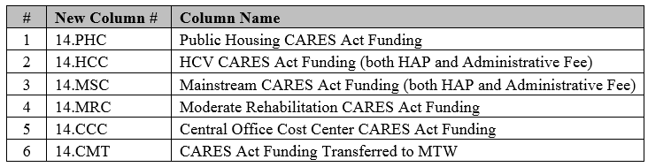
FDS Reporting - New Columns
If a PHA has received CARES Act funding from any one of the following four sources, 1) Public Housing Operating Fund, 2) HCV, 3) Mainstream Voucher, and/or 4) Moderate Rehabilitation programs, the PHA is required to add the respective reporting column(s) in its FASS-PH submission
14.CCC - Central Office Cost Center. For PHAs that operate with a COCC, 14.CCC will be used to account and report any transfer and use of supplemental funds above the safe-harbor rates to the PHA’s COCC
14.CMT – Funding Transferred to MTW. For MTW PHAs, 14.CMT will be used to account and report the transfer and use of supplemental funds used to support the PHA’s MTW program
Appendix 1 of the Notice provides detailed instructions on how to add the columns

Slide 14
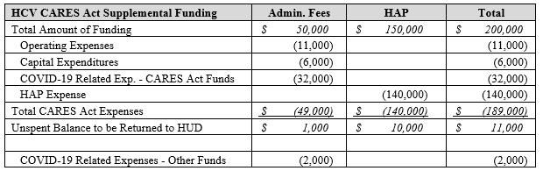
Example – HCV CARES Act Funding
Example Information
HUD disbursed to the PHA $50,000 in CARES Act supplemental HCV administrative fees and $150,000 in HAP funds.
The PHA used $6,000 of the supplemental administrative fees to purchase IT equipment to allow employees to work from home. These costs were capitalized.
The PHA used $11,000 of the supplemental administrative fees to fund salaries, benefits, and office supplies.
The PHA also used $32,000 of the supplemental administrative fees to pay for COVID-19 related activity. Of this amount, $5,000 has not yet been paid by the PHA.
The PHA used $2,000 of FY 2020 administrative fees to support COVID-19 costs.
The PHA incurred and paid $140,000 in HAP expense using its supplemental HAP funding.
The PHA has $11,000 of unspent CARES Act funds at the end of their fiscal year.
The table below provides a summary of the transaction described above.
14
Notes:
The period of availability is the time the funds must be spent by. Unless is a MTW PHA, PHAs cannot use Admin fees for HAP purposes.

Slide 15
Example – HCV CARES Act Funding
New Reporting Column
1. $189,000 of HCV admin. fee and HAP funds that are recognized as revenue as the PHA incurred $189,000 of eligible expenses.
2. $11,000 of CARES Act HCV admin. fees spent on administrative costs of the HCV program.
3. $34,000 of expenses used to prepare for, prevent and responded to COVID-19.
4. $140,000 of housing assistance payments paid from HCV Cares HAP funds.
5. $2,000 of 2020 HCV administrative fees were used to support COVID-19 relief activities (i.e., supports the $34,000).
6. $6,000 purchase of laptops (capitalized costs).
Note 1: Due to system limitations and unlike the HCV program column on the FDS, 14.HCC will not have detail FDS line items that separates HUD funding available for administrative fees versus HAP.
Notes:
The period of availability is the time the funds must be spent by. Unless is a MTW PHA, PHAs cannot use Admin fees for HAP purposes.

Slide 16
Example – HCV CARES Act Funding
New Reporting Column
1. $5,000 of recent COVID-19 costs that were incurred by the PHA, but accounting is still processing the payment to the vendor.
2. $11,000 of HCV CARES Act funds in the PHA’s bank account. The amount is unearned revenue as the PHA has not yet incurred an eligible expense. If the funds remain unspent, these funds will need to be returned to HUD.
3. No Equity / Net Position as CARES Act funds cannot build reserves.
Current assets should match current liabilities.
Notes:
The period of availability is the time the funds must be spent by. Unless is a MTW PHA, PHAs cannot use Admin fees for HAP purposes.

Slide 17
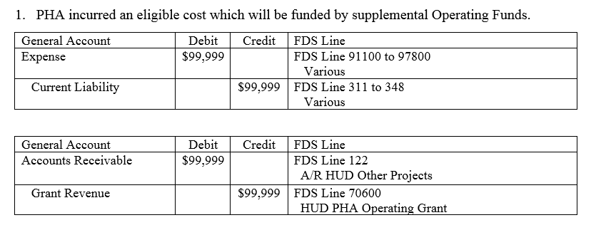
Example Accounting Entries CARES Act Operating Funds
Journal Entry
PHA incurs an eligible cost which will be paid from CARES Act Operating Funds
With an eligible cost incurred, revenue recognition requirements are complete and the PHA will book grant revenue as the earning process is complete
Since these are Operating Funds that have not been draw-down, the PHA also books an accounts receivable
Notes:
PBV assisted units include RAD PBV and regular PBVs.

Slide 18
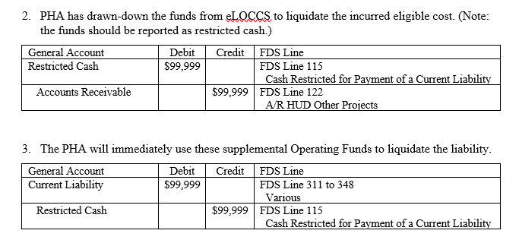
Example Accounting Entries CARES Act Operating Funds
Journal Entry
The PHA now meets the immediate need requirements
Since the PHA has incurred a liability, the PHA can now draw down the funds from eLOCCS, which the PHA must use to liquidate that specific liability
The PHA is now required to pay the vendor immediately so the funds are not comingled with reserves

Slide 19
FDS Reporting Details
PIH Notice 2020-24 provides detailed reporting instructions for the following programs/topics:
Section | Reporting Instructions for:
6. | CARES Act HCV and Mainstream Funding
7. | CARES Act Operating Funds
9. | COCC Fees in Excess of the Safe Harbor amounts
10. | MTW Demonstration program
11. | Moderate Rehabilitation program
12. | Schedule of Expenditures of Federal Awards (SEFA)

Slide 20
Quarterly Reporting Requirements

Slide 21
Quarterly Reporting Requirements
The CARES Act requires that recipients and sub-recipients of CARES Act funds satisfy quarterly reporting requirements.
HUD will provide PHAs with a reporting portal for quarterly reporting.
This reporting portal is under development and is not yet available to PHAs.
Until the reporting portal becomes available to PHAs, PHA quarterly reporting requirements are suspended.
It is expected that the first quarterly reporting by PHAs will be October 10th, 2020. However, this reporting target date may be delayed as the reporting portal is still being implemented.

Slide 22
Quarterly Reporting Requirements
The CARES Act requires reporting on “Large Covered Funds” (CARES Act awards over $150,000) with the following information required to be reported:
Amount received,
Amount expended or obligated,
Name of project or activity,
Description of project or activity, and
Number of jobs created
The $150,000 threshold for reporting is based on all CARES Act fund awarded to the PHA, regardless of source
Once PHA is over the $150,000 reporting threshold , the PHA must report on all CARES Act funds, regardless of award amount
The reporting must be at the grant level and at least one level below the grant award. Reporting is due 10 days after the quarter end (e.g., July 10th, October 10th).

Slide 23
Quarterly Reporting Requirements
When reporting, PHAs must report using the accrual basis of accounting.
Reporting will be completed at the activity level for each CARES Act award.
For PHAs, HUD will establish six award types
CARES Act Operating Fund
CARES Act HCV Administrative Fee
CARES Act HCV HAP
CARES Act Mainstream Administrative Fee
CARES Act Mainstream HAP
CARES Act Moderate Rehabilitation HAP
Note: PIH may make two or more awards to a PHA from the same CARES Act funding, such as HCV administrative fees. For quarterly reporting, the PHA will be instructed to report both awards together.

Slide 24
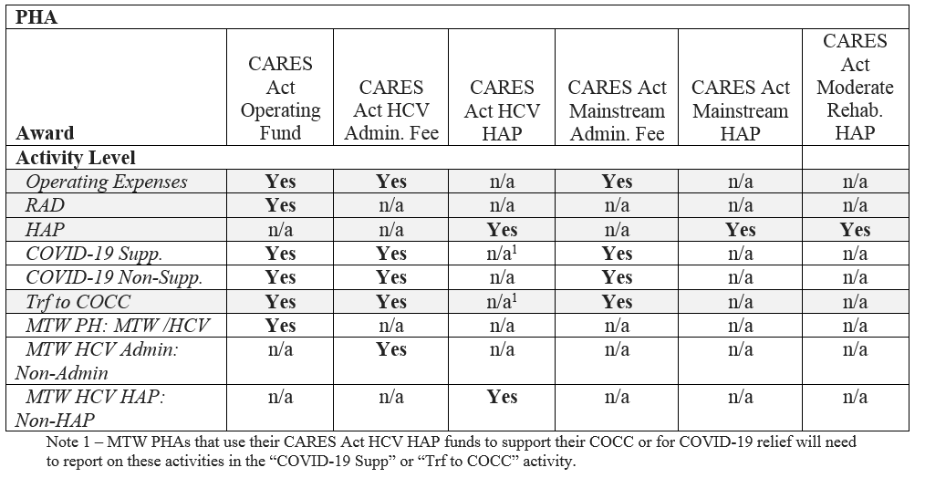
Quarterly Reporting Requirements Activity Levels
Activity levels will be defined by HUD for each award level.
The CARES Act quarterly reporting will be at one level below the award.

Slide 25
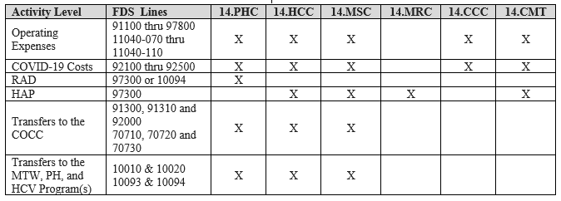
25
25
Quarterly Reporting Requirements
FDS Line Items vs. Activity Level
HUD must be able to reconcile the PHA’s quarterly CARES Act reporting to the PHA’s FDS reporting.
Notes:
Good to go

Slide 26
Quarterly Reporting Requirements Quarterly Reporting Aligned to FDS
26
26
Notes:
Good to go

Slide 27
Quarterly Reporting Activity Level Reporting For MTW PHAs
27
27
Quarterly Reporting Requirements
MTW PHAs
The Notice contains further detailed reporting instruction for MTW PHAs.
An MTW PHA is prohibited from transferring all PH or HCV CARES Act funds to PH, HCV and/or MTW, etc. and then transfer those funds back into the HCV or PH programs to minimize quarterly reporting.
For example, a MTW PHA is not allowed to transfer its PH CARES Act funds to MTW, which for quarterly CARES Act reporting would be reported as one line item “PH Transfer to the MTW or HCV Program” and then transfer the funds back to its public housing program and spend the funds at the projects.
This language applies to reporting and does not limit the MTW PHAs’ flexibility on the use of their funds.
Notes:
Good to go

Slide 28
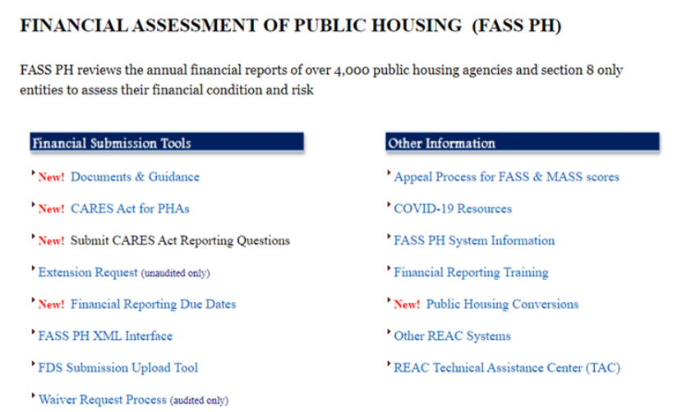
Submit CARES ACT FDS Reporting Questions online or via call to REAC's TAC: https://www.hud.gov/program_offices/public_indian_housing/reac/support/tac
Reporting Questions and Answers
FASS-PH Website:
https://www.hud.gov/program_offices/public_indian_housing/reac/products/prodpha
Submit CARES ACT FDS Reporting Questions directly to the FASS-PH team:
Inbox currently being established
Look for Responses to Frequently Asked Questions to be posted on this main page at:
https://www.hud.gov/program_offices/public_indian_housing/reac/products/prodpha/cares_act_fds_reporting_faqs

