Slide 1
232 Healthcare Portal Instructions for 232 Lenders
Processing a Reserve for Replacement Request
Presented by Tiffani Tyer

Slide 2
SUBMITTING A RESERVE FOR REPLACEMENT ESCROW REQUESTS
There are two types of Reserve for Replacement request submissions:
  Lender Delegated:
    Approved by Lender:
      Follow instructions for Non-Lender Delegated submissions, also enter the “Total Accepted Amount”.
      No further action required by HUD.
  Non-Lender Delegated:
    May be Auto approved - No additional action required by HUD.
    Forwarded to AE for further review.

Slide 3
REVIEWING AND PROCESSING RESERVE FOR REPLACEMENT ESCROW REQUESTS
This section will provide instructions on submitting a Reserve for Replacement (R4R) requests submitted by HUD approved Lenders.
  Click on the Asset Management tab.
  Click on Reserve for Replacement Submission Form
  Enter the Date of Borrower’s Request – This information comes from the date the Borrower/Agent signed the 9250a that was submitted.
    The Date of Servicer’s Submission will populate automatically.

Slide 4
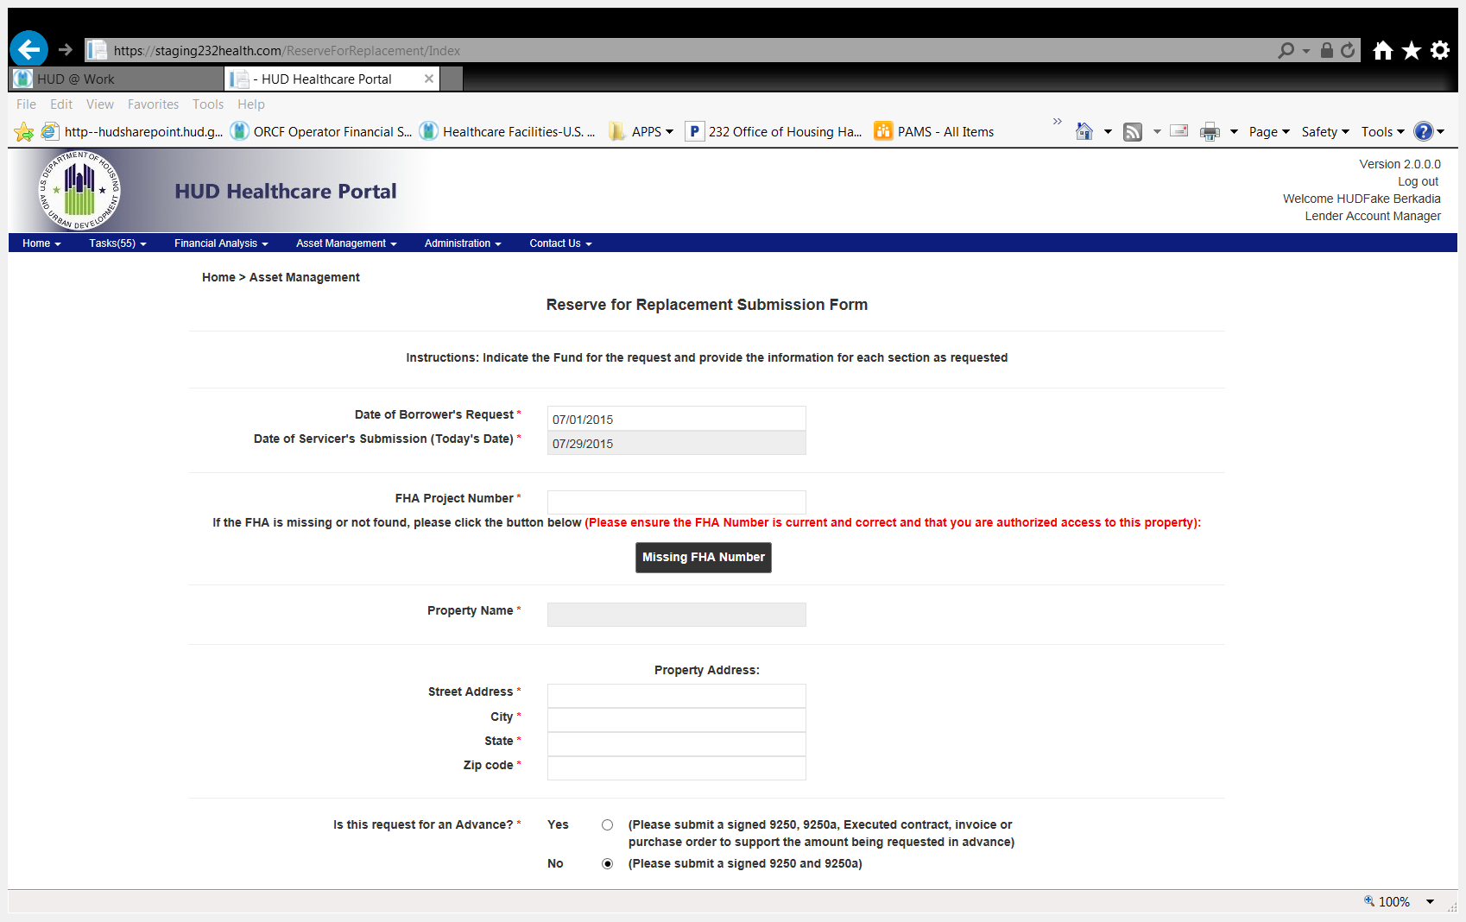

Slide 6
Enter the FHA Number of the property:
  You can either select the FHA number by typing at least the first digit
  You can enter the entire FHA number, including the dash (-) to locate the FHA number of the property you are submitting a Reserve for Replacement request for.

Slide 7
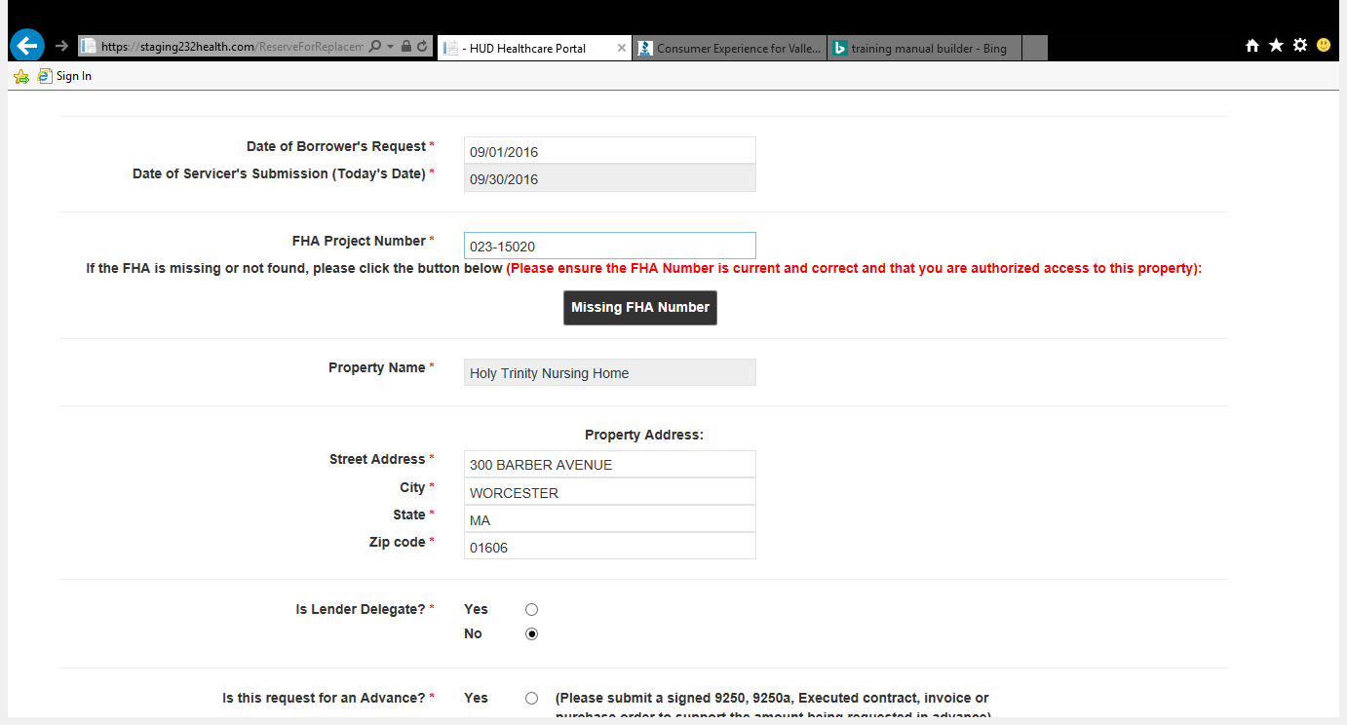

Slide 8
If the property’s FHA Number is not available in your drop-down list:
  Select the “Missing FHA Number” button and enter the required information and click Submit.
  Please note that if the property’s FHA Number is missing, you will have to submit the Reserve for Replacement Request to the Reserve for Replacement Team via e-mail (232R4Rrequest@hud.gov).

Slide 9
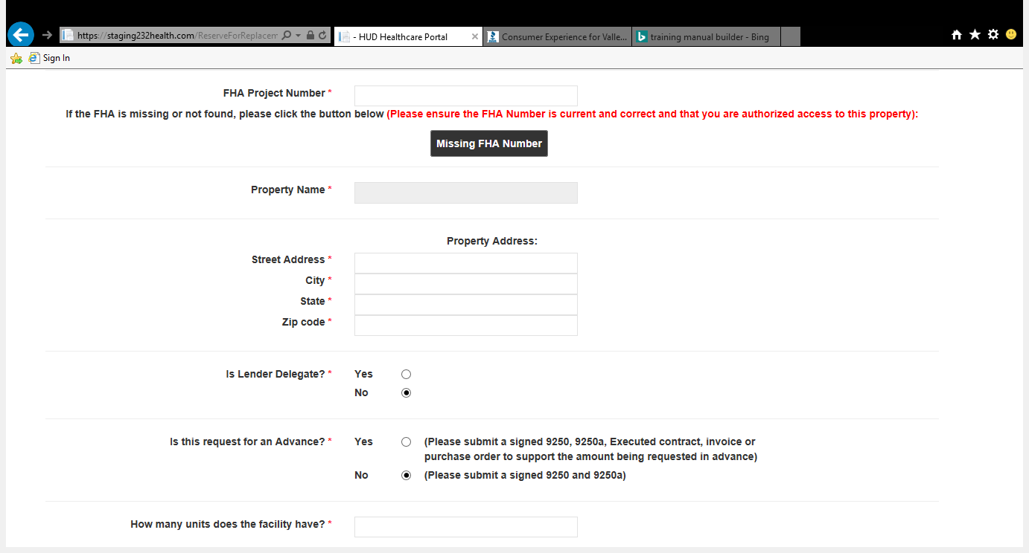
Notes:
If you attempt to enter the FHA number, but receive no results, you must click on the “Missing FHA Number” tab and enter the required information, to have the FHA number entered into the Portal for future use.

Slide 10
Notes:
If you attempt to enter the FHA number, but receive no results, you must click on the “Missing FHA Number” tab and enter the required information, to have the FHA number entered into the Portal for future use.

Slide 11
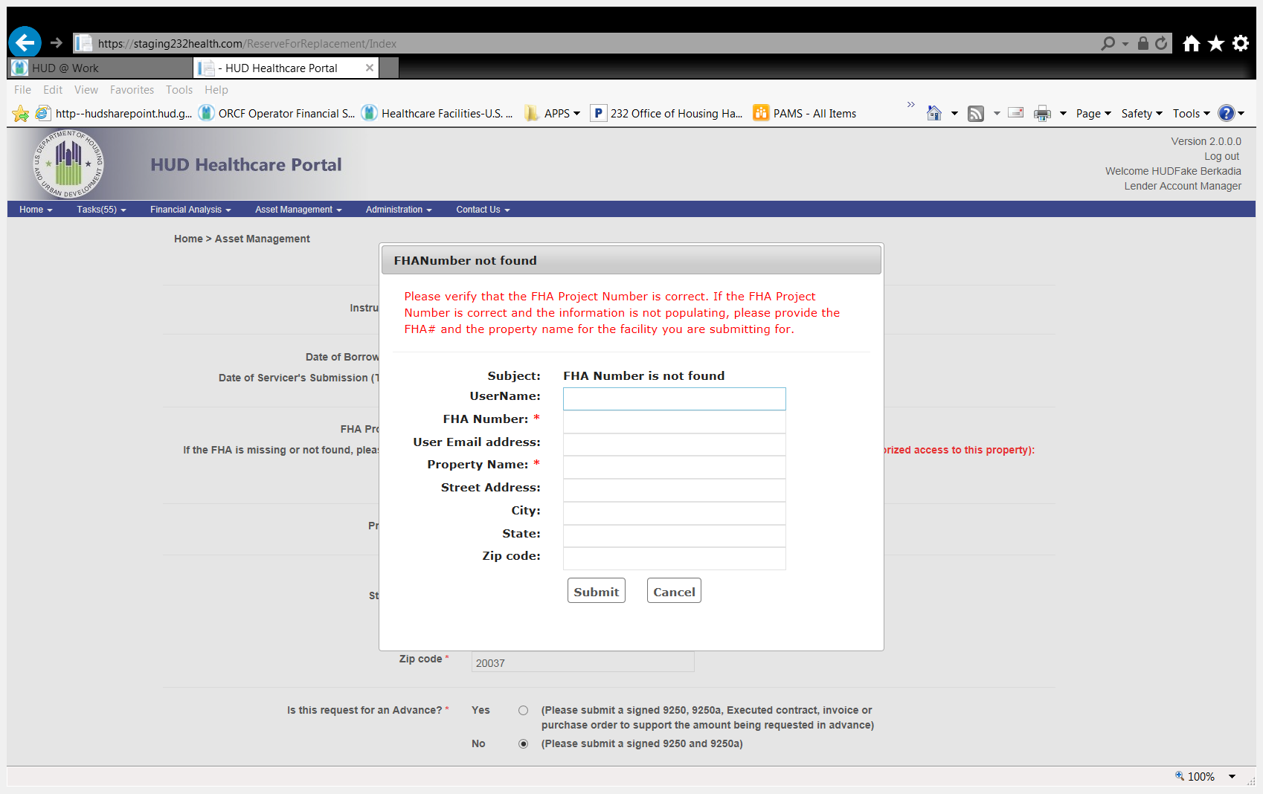
Notes:
The FHA Number Not Found box will pop up. Enter the required information and submit it. This request will be sent to the HHCP Customer Service e-mail box, where it will be processed accordingly.

Slide 12
The Property Name automatically fills once the property’s FHA Number is selected.
Review the Property Address for accuracy:
  Street Address
  City
  State
  Zip Code
Notes:
If the FHA number is available, the Property’s name and address will automatically fill.

Slide 13


Slide 14
If any part of the address is incorrect, make the necessary changes, and an e-mail will be sent to HUD Administrators to be updated in our systems.
Please note that this update may take 5 to 10 business days.

Slide 16
Select Yes if you are submitting as a Lender Delegate (complete the remaining sections of the form and send HUD your decision).

Slide 18
Select the appropriate radio button to verify if the request is for an Advance of funds (Please note that this is a required field):
  If the request is for an advance of funds, you will be directed to upload an unexpired OHP 9250, 9250a and any contract or evidential information you may have regarding this request.
  If the request is not for an advance of funds, you will attach an unexpired OHP 9250 and 9250a.

Slide 19
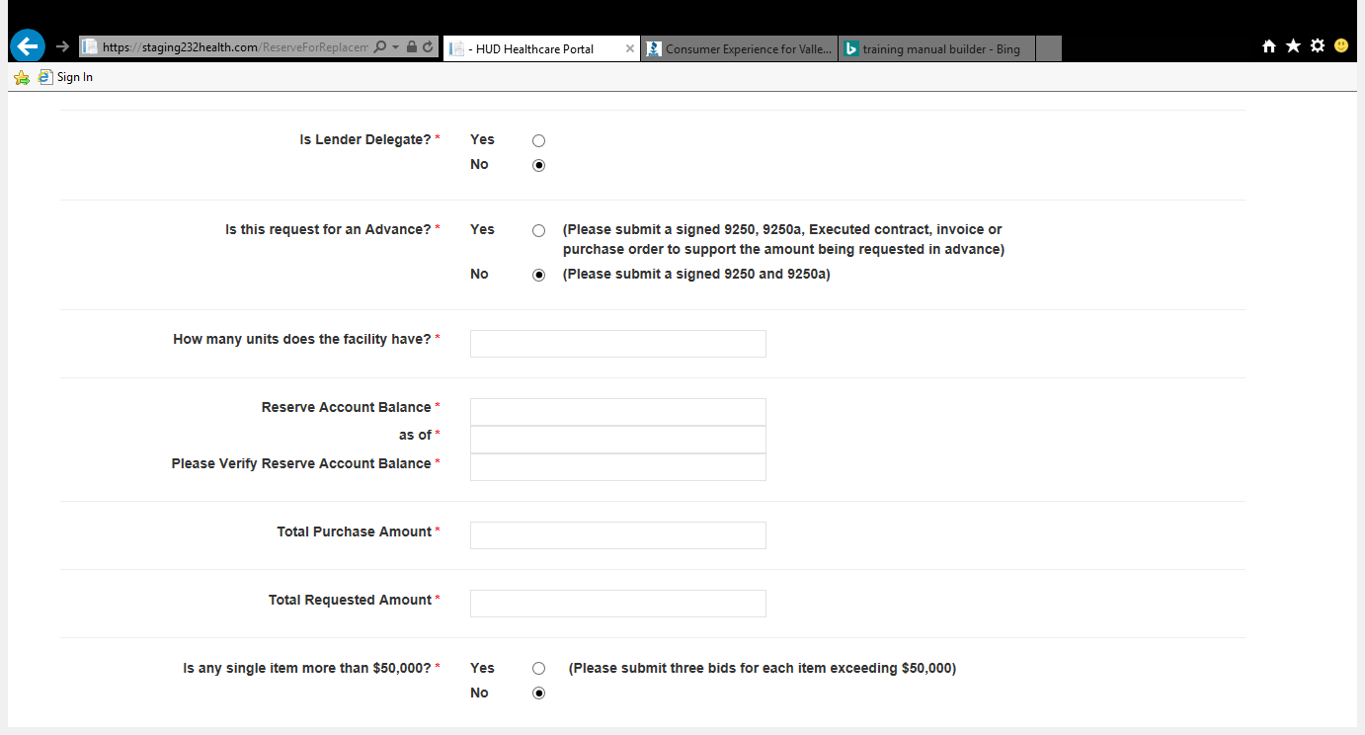

Slide 20
ENTER THE REMAINING INFORMATION AS REQUIRED
How many units does the facility have? - Enter the number of units in the facility – this amount is the number of rooms the facility is licensed for.
Reserve Account Balance - Enter the Reserve Account Balance for this property.
As of - Enter the date of which you are providing the Reserve Account Balance for.

Slide 22
Please Verify Reserve Account Balance - Re-enter the Reserve Account Balance for validation purpose.
Total Purchase Amount - Enter the amount of the total purchase amounts.
Total Requested Amount – This is the amount that’s being requested for reimbursement

Slide 23
Is any single item greater than $50,000 - Select the appropriate radio button to determine if there is any single item greater than $50,000.
  If yes, please submit three bids for each item exceeding $50,000.
  If no, continue to the next questions.
Were any of the items purchased more than 365 days ago? – Select the appropriate radio button to determine if there is any purchase more than 365 days older than the R4R request.
  If yes, please submit all invoices, receipts, contracts, pictures, etc.

Slide 24
Does the R4R request propose remodeling, adding to, subtracting from, reconstruction, or demolishing a portion of the mortgaged project? - Select the appropriate radio button and attached documents accordingly.
Is the release being used to cover any portion of the mortgage? – Select the appropriate radio button and attached documents accordingly.

Slide 25
Servicer Comments – Select the appropriate radio button to signify that you would like to leave a comment. You can enter up to 50 characters into this field, to be seen by HUD.

Slide 26
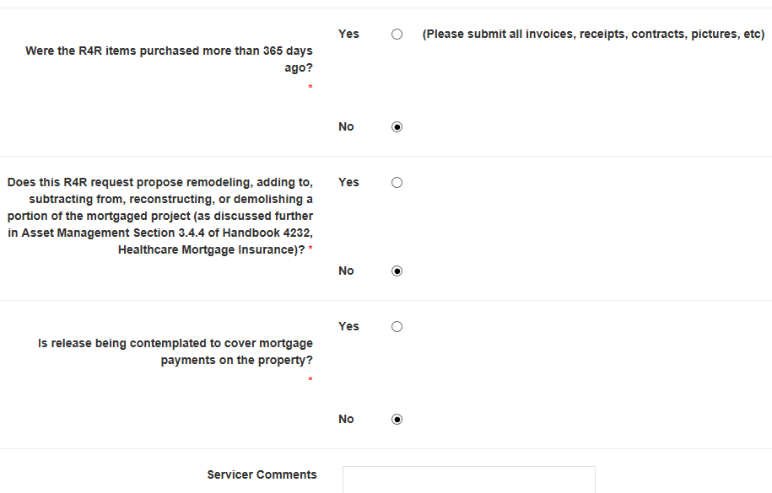

Slide 27
Enter the required Evidential Information, such as the most current 9250, 9250a and any additional documents identified throughout the submission process.
Attach Other - Attach documents that cannot be titled as an Invoice, receipt, contract, or picture.
  If you attach “Other” documents, please describe the type of document you are submitting.

Slide 28
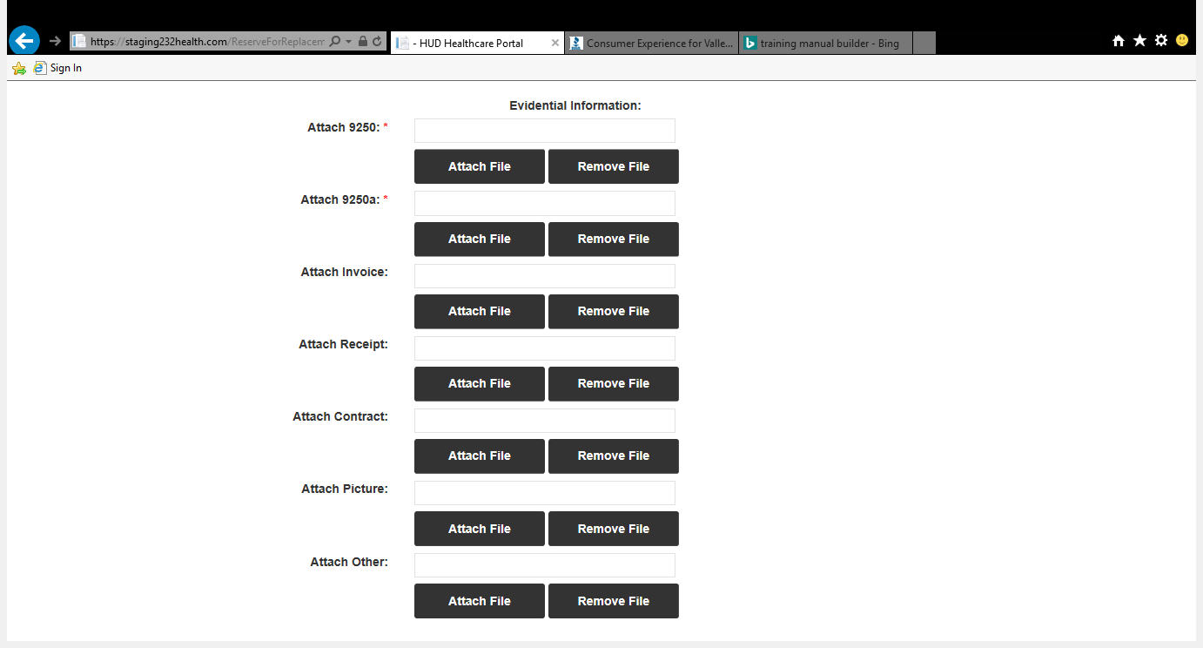

Slide 29
Read and accept the Acknowledgement language before submission.

Slide 30
Submit – Click submit when you have entered all required information and attached all required documents.
  If you are a Lender Delegate, your recommendation will immediately be captured, and you will receive an e-mail notifying you of HUD’s receipt of the Reserve for Replacement Decision.
  If the submission is not Lender Delegated, and the request is auto-approved, you will receive an e-mail notifying you of the auto-approval.
  If the submission is not Lender Delegated or auto-approved, you will receive an e-mail, notifying you of the request being reviewed by the HUD Account Executive (AE).
    Following HUD AE review/decision, you will receive an e-mail containing the results of the request.

Slide 31
After submitting the request, the Portal will automatically take you to the “My Task” section of the Portal where you can view the submission and its status.

Slide 32
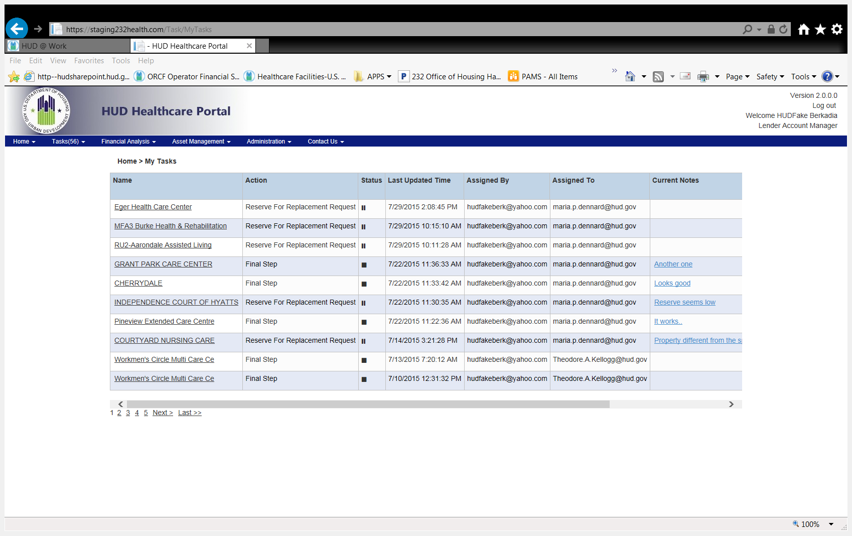
Notes:
Discuss what the symbols mean.

Slide 33
You have now submitted a Reserve for Replacement request for this property.
Notes:
Discuss what the symbols mean.

Slide 34
Who to Contact?
Please e-mail your 232 Healthcare Portal questions or concerns to the
232 Healthcare Portal Help Desk at
HHCP@HUD.GOV

Slide 35

Questions

